Slide 1
Unit-4 Marketing Management
Topics to be covered as per syllabus
Functions of Marketing
Marketing Vs Sales
Interface of Marketing with Other Depts
Customer Life Time Value
New Product Development
Unethical Issues in Marketing

Slide 2
What Is Marketing?
Marketing is about identifying and meeting human and social needs. One of the shortest good definitions of marketing is “meeting needs profitably.”
Example: When eBay recognized that people were unable to locate some of the items they desired most, it created an online auction clearinghouse.
When IKEA noticed that people wanted good furnishings at substantially lower prices, it created knockdown furniture
These two firms demonstrated marketing savvy and turned a private or social need into a profitable business opportunity

Slide 3
What Is Marketing Management?
The American Marketing Association offers the following formal definition: Marketing is the activity, set of institutions, and processes for creating, communicating, delivering, and exchanging offerings that have value for customers, clients, partners, and society at large.
Coping with these exchange processes calls for a considerable amount of work and skill. Marketing management takes place when at least one party to a potential exchange thinks about the means of achieving desired responses from other parties.
Marketing Management is the art and science of choosing target markets and getting, keeping, and growing customers through creating, delivering, and communicating superior customer value

Slide 4
Social definition of Marketing
A social definition shows the role marketing plays in society; for example, one marketer has said that marketing’s role is to “deliver a higher standard of living.”
Here is a social definition that serves our purpose: Marketing is a societal process by which individuals and groups obtain what they need and want through creating, offering, and freely exchanging products and services of value with others.

Slide 5
Marketing V/s Selling
Managers sometimes think of marketing as “the art of selling products,” but many people are surprised when they hear that selling is not the most important part of marketing!
Selling is only the tip of the marketing iceberg. Peter Drucker, a leading management theorist, puts it this way:
There will always, one can assume, be need for some selling. But the aim of marketing is to make selling superfluous. The aim of marketing is to know and understand the customer so well that the product or service fits him and sells itself. Ideally, marketing should result in a customer who is ready to buy. All that should be needed then is to make the product or service available.

Slide 6
Marketing
Selling
Marketing focuses on creating demand and building relationships by identifying customer needs and promoting products.
Marketing takes a long-term, customer-centric approach to build brand awareness and loyalty.
Goal: To generate demand and build brand awareness and customer loyalty over the long term.
Focus: (Pull Based Model) Understanding customer needs, developing products to meet those needs, and communicating their value to the market.
Activities: Includes market research, advertising, content creation, social media engagement, and public relations to attract and nurture potential customers.
Time Horizon: Long-term strategic planning and relationship building.
Selling is the act of converting that interest into immediate revenue by persuading customers to make a purchase.
Selling prioritizes short-term transactions and profit through a direct exchange of money for goods or services.
Goal: To convert interest into immediate sales and revenue by exchanging a product or service for money.
Focus: Persuading a customer to make a purchase and completing the transaction. Push Based Model.
Activities: Direct interaction with buyers, demonstrating products, and negotiating terms of sale & purchase.
Time Horizon: Short-term focus on individual transactions and immediate profits.

Slide 7
What Is Marketed?
Marketers market 10 main types of entities:
GOODS: Physical goods constitute the bulk of most countries’ production and marketing efforts. Each year, companies market billions of fresh, canned, bagged, and frozen food products and millions of cars, refrigerators, televisions, machines, and other mainstays of a modern economy
SERVICES: As economies advance, a growing proportion of their activities focuses on the production of services. The U.S. economy today produces a 70–30 services-to-goods mix. Services include the work of airlines, hotels, car rental firms, barbers and beauticians, maintenance and repair people, and accountants, bankers, lawyers, engineers, doctors, software programmers, and management consultants. Many market offerings mix goods and services, such as a fast-food meal

Slide 8
EVENTS: Marketers promote time-based events, such as major trade shows, artistic performances, and company anniversaries. Global sporting events such as the Olympics and the World Cup are promoted aggressively to both companies and fans
EXPERIENCES: By orchestrating several services and goods, a firm can create, stage, and market experiences. Walt Disney World’s Magic Kingdom allows customers to visit a fairy kingdom, a pirate ship, or a haunted house. There is also a market for customized experiences, such as a week at a baseball camp with retired baseball greats, a four-day rock and roll fantasy camp, or a climb up Mount Everest
PERSONS: Artists, musicians, CEOs, physicians, high-profile lawyers and financiers, and other professionals all get help from celebrity marketers. Some people have done a masterful job of marketing themselves—David Beckham, Oprah Winfrey, and the Rolling Stones. Management consultant Tom Peters, a master at self-branding, has advised each person to become a “brand

Slide 9
PLACES: Cities, states, regions and whole nations compete to attract tourists, residents, factories, and company headquarters. Place marketers include economic development specialists, real estate agents, commercial banks, local business associations, and advertising and public relations agencies. Example: The promotion of Kumbh Mela & Varanasi for Heritage Tourism, Kerala as God’s Own Country.
PROPERTIES: Properties are intangible rights of ownership to either real property (real estate) or financial property (stocks and bonds). They are bought and sold, and these exchanges require marketing. Real estate agents work for property owners or sellers, or they buy and sell residential or commercial real estate. Investment companies and banks market securities to both institutional and individual investors.
ORGANIZATIONS: Organizations work to build a strong, favorable, and unique image in the minds of their target publics. In the United Kingdom, Tesco’s “Every Little Helps” marketing program reflects the food marketer’s attention to detail in everything it does, within the store and in the community and environment. The campaign has vaulted Tesco to the top of the UK supermarket chain industry. Universities, museums, performing arts organizations, corporations, and nonprofits all use marketing to boost their public images and compete for audiences and funds.

Slide 10
IDEAS: Every market offering includes a basic idea. Charles Revson of Revlon once observed: “In the factory we make cosmetics; in the drugstore we sell hope.” Products and services are platforms for delivering some idea or benefit. These days we see that Social Marketers are busy promoting such ideas as “Tinder - It Starts with a Swipe”, “Dove Finds Beauty In Everyone”, Coca-Cola’s “Share A Coke” Campaign, Nike’s “Just Do It” Campaign, etc.
INFORMATION: The production, packaging, and distribution of information are major industries. Information is essentially what books, schools, and universities produce, market, and distribute at a price to parents, students, and communities. The former CEO of Siemens Medical Solutions USA, Tom McCausland, says, “[our product] is not necessarily an X-ray or an MRI, but information. Our business is really health care information technology, and our end product is really an electronic patient record: information on lab tests, pathology, and drugs as well as voice dictation.”

Slide 11
Who Markets?
MARKETERS AND PROSPECTS: A marketer is someone who seeks a response — attention, a purchase, a vote, a donation — from another party, called the prospect. If two parties are seeking to sell something to each other, we call them both marketers.
Marketers are skilled at stimulating demand for their products, but that’s a limited view of what they do. Just as production and logistics professionals are responsible for supply management, marketers are responsible for demand management. They seek to influence the level, timing, and composition of demand to meet the organization’s objectives.

Slide 12
Eight demand states are possible:
Negative demand — Consumers dislike the product and may even pay to avoid it. For example: people prefer to avoid dental procedures and focus on preventive measures to keep their teeth healthy, rather than experiencing dental work
Nonexistent demand — Consumers may be unaware of or uninterested in the product. For Example: Products like typewriters or pagers have nonexistent demand because consumers are no longer aware or interested in them.
Latent demand — Consumers may share a strong need that cannot be satisfied by an existing product. For Example: The desire for a disease like cancer, but there is no such medicine or treatment available in the market yet that could fulfill that demand.
Declining demand — Consumers begin to buy the product less frequently or not at all. For Example: Products like CD’s & DVD’s have declining demand in this era when people have moved to digital streaming platforms and other drives.
Irregular demand — Consumer purchases vary on a seasonal, monthly, weekly, daily, or even hourly basis. For Example: Sales of Air Conditioner’s, rain coats, umbrella, etc.
Full demand — Consumers are adequately buying all products put into the marketplace. For Example: Sale of tickets of superhit movies.
Overfull demand — More consumers would like to buy the product than can be satisfied. For Example: Demand of toilet papers, hand sanitizer’s, oxygen cylinders, etc.
Unwholesome demand — Consumers may be attracted to products that have undesirable social consequences. Example: Demand for cigarettes, Pan Masala and all such sin goods that have negative social consequences.
In each case, marketers must identify the underlying cause(s) of the demand state and determine a plan of action to shift demand to a more desired state

Slide 13
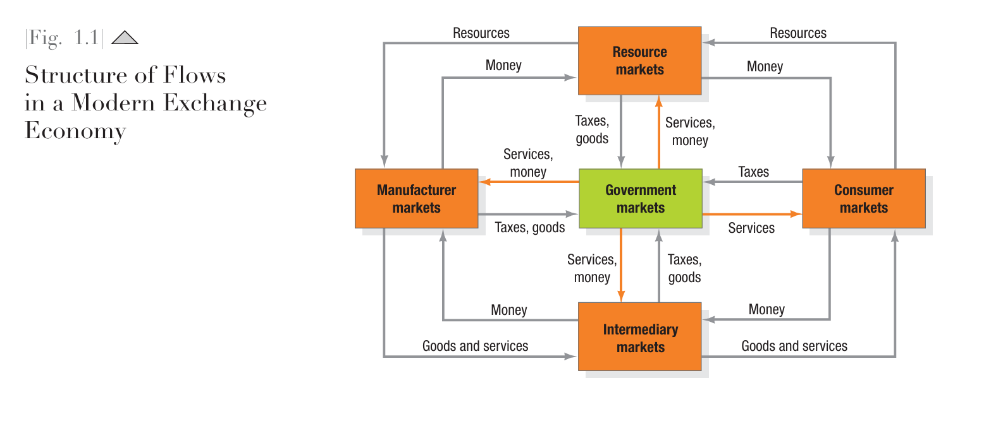

Slide 14
Traditionally, a “market” was a physical place where buyers and sellers gathered to buy and sell goods. Economists describe a market as a collection of buyers and sellers who transact over a particular product or product class (such as the housing market or the grain market).
Five basic markets and their connecting flows are shown in Figure 1.1 in the previous slide.
Manufacturers go to resource markets (raw material markets, labor markets, money markets), buy resources and turn them into goods and services, and sell finished products to intermediaries, who sell them to consumers.
Consumers sell their labor and receive money with which they pay for goods and services.
The government collects tax revenues to buy goods from resource, manufacturer, and intermediary markets and uses these goods and services to provide public services.
Each nation’s economy, and the global economy, consists of interacting sets of markets linked through exchange processes.
Marketers use the term market to cover various groupings of customers. They view sellers as constituting the industry and buyers as constituting the market. They talk about need markets (the diet-seeking market), product markets (the shoe market), demographic markets (the youth market), and geographic markets (the Chinese market).

Slide 15
Needs, Wants, and Demands
Needs are the basic human requirements such as for air, food, water, clothing, and shelter. Humans also have strong needs for recreation, education, and entertainment. These needs become wants when they are directed to specific objects that might satisfy the need. A U.S. consumer needs food but may want a Philly cheesesteak and an iced tea. A person in Afghanistan needs food but may want rice, lamb, and carrots. Wants are shaped by our society.
Demands are wants for specific products backed by an ability to pay. Many people want a Mercedes; only a few are able to buy one. Companies must measure not only how many people want their product, but also how many are willing and able to buy it.
These distinctions shed light on the frequent criticism that “marketers create needs” or “marketers get people to buy things they don’t want.” Marketers do not create needs: Needs preexist marketers. Marketers, along with other societal factors, influence wants. They might promote the idea that a Mercedes would satisfy a person’s need for social status. They do not, however, create the need for social status.

Slide 16
Some customers have needs of which they are not fully conscious or that they cannot articulate. We can distinguish five types of needs:
Stated needs (The customer wants an inexpensive car.)
Real needs (The customer wants a car whose operating cost, not initial price, is low.)
Unstated needs (The customer expects good service from the dealer.)
Delight needs (The customer would like the dealer to include an onboard GPS navigation system.)
Secret needs (The customer wants friends to see him or her as a savvy consumer.)
Responding only to the stated need may shortchange the customer. Consumers did not know much about cellular phones when they were first introduced, however Nokia and Ericsson fought to shape consumer perceptions of them. To gain an edge, companies must help customers learn what they want.

Slide 17
Target Markets, Positioning, and Segmentation
Not everyone likes the same cereal, restaurant, college, or movie. Therefore, marketers start by dividing the market into segments.
They identify and profile distinct groups of buyers who might prefer or require varying product and service mixes by examining demographic, psychographic, and behavioral differences among buyers.
After identifying market segments, the marketer decides which present the greatest opportunities — which are its target markets.
For each, the firm develops a market offering that it positions in the minds of the target buyers as delivering some central benefit(s). For Example: Volvo develops its cars for buyers to whom safety is a major concern, positioning its vehicles as the safest a customer can buy.

Slide 18
Offerings and Brands
Companies address customer needs by putting forth a value proposition, a set of benefits that satisfy those needs. The intangible value proposition is made physical by an offering, which can be a combination of products, services, information, and experiences.
A brand is an offering from a known source. A brand name such as McDonald’s carries many associations in people’s minds that make up its image: hamburgers, cleanliness, convenience, courteous service, and golden arches. All companies strive to build a brand image with as many strong, favorable, and unique brand associations as possible.

Slide 19
Value and Satisfaction
The buyer chooses the offerings he or she perceives to deliver the most value, the sum of the tangible and intangible benefits and costs to her.
Value, a central marketing concept, is primarily a combination of quality, service, and price (QSP), called the customer value triad.
Value perceptions increase with quality and service but decrease with price.
We can think of marketing as the identification, creation, communication, delivery, and monitoring of customer value.
Satisfaction reflects a person’s judgment of a product’s perceived performance in relationship to expectations.
If the performance falls short of expectations, the customer is disappointed. If it matches expectations, the customer is satisfied. If it exceeds them, the customer is delighted

Slide 20
Marketing Channels
To reach a target market, the marketer uses three kinds of marketing channels.
Communication Channels deliver and receive messages from target buyers and include newspapers, magazines, radio, television, mail, telephone, billboards, posters, fliers, CDs, audiotapes, and the Internet. Beyond these, firms communicate through the look of their retail stores and Web sites and other media. Marketers are increasingly adding dialogue channels such as e-mail, blogs, and toll-free numbers to familiar monologue channels such as ads.
The marketer uses Distribution Channels to display, sell, or deliver the physical product or service(s) to the buyer or user. These channels may be direct via the Internet, mail, or mobile phone or telephone, or indirect with distributors, wholesalers, retailers, and agents as intermediaries.
To carry out transactions with potential buyers, the marketer also uses Service Channels that include warehouses, transportation companies, banks, and insurance companies. Marketers clearly face a design challenge in choosing the best mix of communication, distribution, and service channels for their offerings.

Slide 21
Supply Chain
The supply chain is a longer channel stretching from raw materials to components to finished products carried to final buyers.
For example: The supply chain for coffee may start with Ethiopian farmers who plant, tend, and pick the coffee beans, selling their harvest to wholesalers or perhaps a Fair Trade cooperative. If sold through the cooperative, the coffee is washed, dried, and packaged for shipment by an Alternative Trading Organization (ATO) that pays a minimum of $1.26 a pound. The ATO transports the coffee to the developing world where it can sell it directly or via retail channels.
Each company captures only a certain percentage of the total value generated by the supply chain’s value delivery system.
When a company acquires competitors or expands upstream or downstream, its aim is to capture a higher percentage of supply chain value

Slide 22
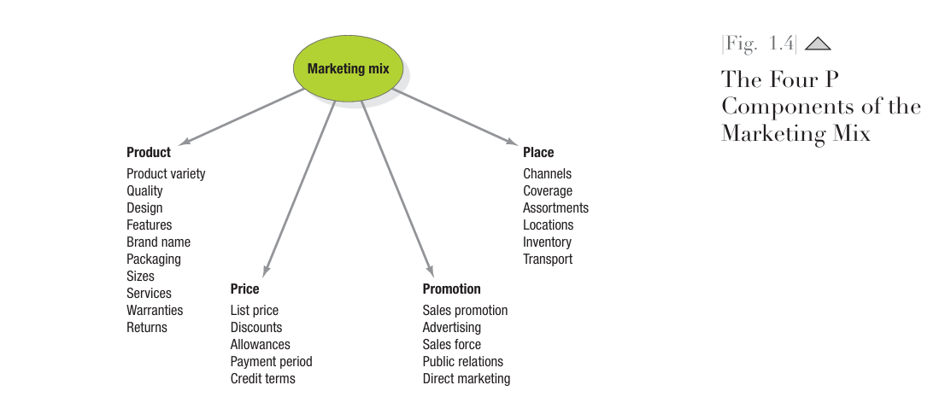
4P’s of Marketing Mix Model

Slide 23
The 4Ps model is a framework of four controllable marketing elements—Product, Price, Place, and Promotion—that a company uses to market its offerings and achieve its marketing goals.
A strategic combination of these four elements, also known as the marketing mix, is designed to meet the needs of a target market by providing the right product at the right price, in the right place, and through the right promotional channels.
Here is a breakdown of each of the 4Ps:
Product: This refers to the actual good or service being offered to customers. It encompasses the product's design, features, quality, branding, packaging, and any associated services or warranties.
Price: This is the amount of money customers are willing to pay for the product or service. Setting the right price is critical, as it influences profitability, consumer perception, and purchasing decisions, and must be linked to the product's perceived value and costs.
Place: This element deals with how the product is distributed and made available to the target customer. It involves decisions about channels, such as physical stores or online platforms, and considers aspects like logistics, storage, and inventory.
Promotion: This involves the communication strategies used to inform, persuade, and remind target customers about the product. It includes activities like advertising, public relations, direct selling, and other promotional tools.

Slide 24
Marketing-mix models analyze data from a variety of sources, such as retailer scanner data, company shipment data, pricing, media, and promotion spending data, to understand more precisely the effects of specific marketing activities.
To deepen understanding, marketers can conduct multivariate analyses, such as regression analysis, to sort through how each marketing element influences marketing outcomes such as brand sales or market share.
Especially popular with packaged-goods marketers such as Procter & Gamble, Clorox, and Colgate, the findings from marketing-mix modeling help allocate or reallocate expenditures. Analyses explore which part of ad budgets are wasted, what optimal spending levels are, and what minimum investment levels should be.
Although marketing-mix modeling helps to isolate effects, it is less effective at assessing how different marketing elements work in combination.

Slide 25
Shortcoming’s of Marketing Mix Model
Wharton School of Business’ Dave Reibstein notes following three shortcomings of Marketing Mix Model:
Marketing-mix modeling focuses on incremental growth instead of baseline sales or long-term effects.
The integration of important metrics such as customer satisfaction, awareness, and brand equity into marketing-mix modeling is limited.
Marketing-mix modeling generally fails to incorporate metrics related to competitors, the trade, or the sales force (the average business spends far more on the sales force and trade pro motion than on advertising or consumer promotion).

Slide 26
The Value Delivery Process
The traditional view of marketing is that the firm makes something and then sells it, with marketing taking place in the selling process.
Companies that subscribe to this view have the best chance of succeeding in economies marked by goods shortages where consumers are not fussy about quality, features, or style—for example, basic staple goods in developing markets.
This traditional view will not work, however, in economies with many different types of people, each with individual wants, perceptions, preferences, and buying criteria.
The smart competitor must design and deliver offerings for well-defined target markets. This realization inspired a new view of business processes that places marketing at the beginning of planning.
Instead of emphasizing making and selling, companies now see themselves as part of a value delivery process.

Slide 27
We can divide the value creation and delivery sequence into three phases
First, choosing the value represents the “homework” marketing must do before any product exists.
Marketers must segment the market, select the appropriate target, and develop the offering’s value positioning. The formula “segmentation, targeting, positioning (STP)”is the essence of strategic marketing.
The second phase is providing the value. Marketing must determine specific product features, prices, and distribution.
The task in the third phase is communicating the value by utilizing the sales force, Internet, advertising, and any other communication tools to announce and promote the product.
The value delivery process begins before there is a product and continues through development and after launch. Each phase has cost implications.

Slide 28
Michael Porter’s Value Chain
Harvard’s Michael Porter has proposed the value chain as a tool for identifying ways to create more customer value.
According to this model, every firm is a synthesis of activities performed to design, produce, market, deliver and support its product.
The value chain identifies nine strategically relevant activities—five primary and four support activities—that create value and cost in a specific business.
The primary activities are (1) inbound logistics, or bringing materials into the business; (2) operations, or converting materials into final products; (3) outbound logistics, or shipping out final products; (4) marketing, which includes sales; and (5) service.
Specialized departments handle the support activities—(1) procurement, (2) technology development, (3) human resource management, and (4) firm infrastructure. (Infrastructure covers the costs of general management, planning, finance, accounting, legal, and government affairs.)

Slide 29
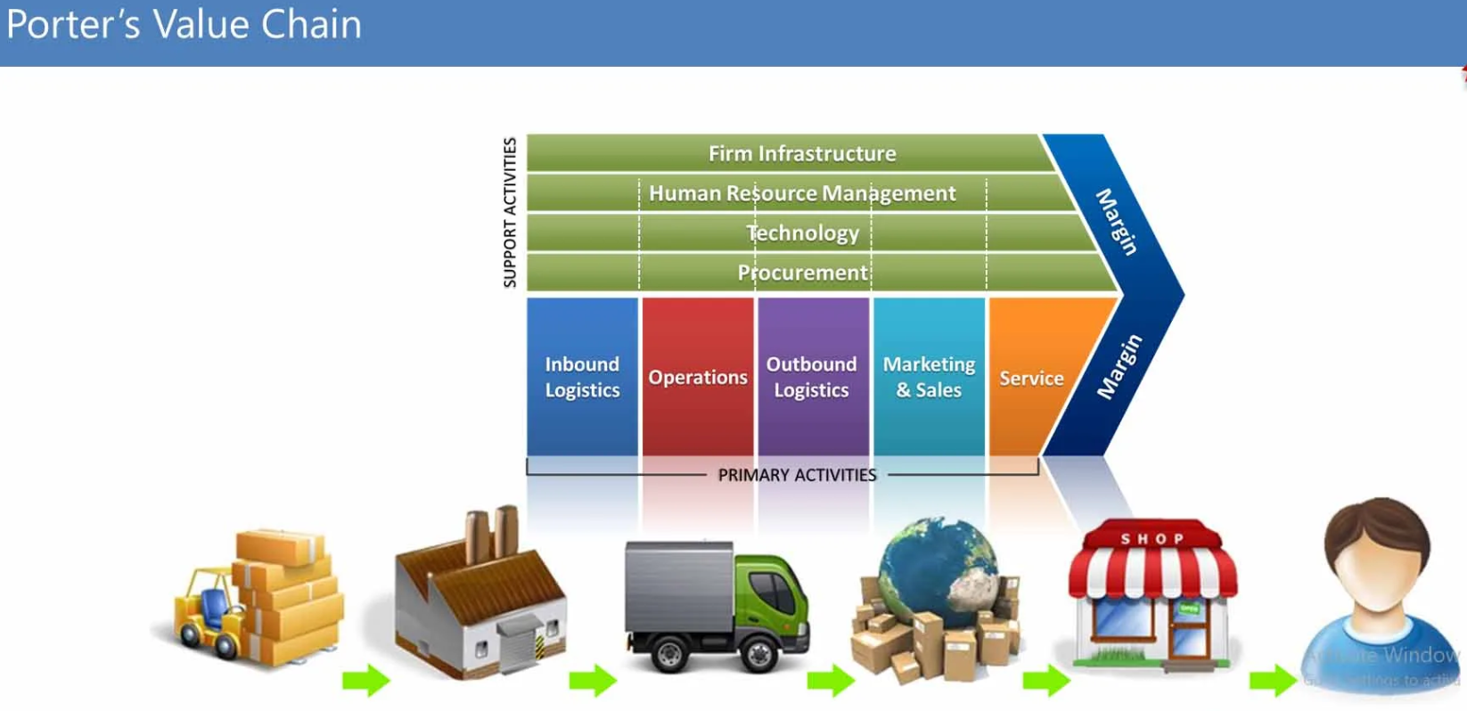

Slide 30
Michael Porter’s Value Chain
The firm’s task is to examine its costs and performance in each value-creating activity and look for ways to improve it.
Managers should estimate competitors’ costs and performances as benchmarks against which to compare their own And they should go further and study the “best of class” practices of the world’s best companies.
We can identify best-practice companies by consulting customers, suppliers, distributors, financial analysts, trade associations, and magazines to see whom they rate as doing the best job.
Even the best companies can benchmark, against other industries if necessary, to improve their performance. For Example: To support its corporate goal to be more innovative, GE has benchmarked against P&G as well as developing its own best practices.
The firm’s success depends not only on how well each department performs its work, but also on how well the company coordinates departmental activities to conduct core business processes.

Slide 31
Michael Porter’s Value Chain
These core business processes are:
The market-sensing process. All the activities in gathering and acting upon information about the market
The new-offering realization process. All the activities in researching, developing, and launching new high-quality offerings quickly and within budget
The customer acquisition process. All the activities in defining target markets and prospecting for new customers
The customer relationship management process. All the activities in building deeper understanding, relationships, and offerings to individual customers
The fulfillment management process. All the activities in receiving and approving orders, shipping the goods on time, and collecting payment
To be successful, a firm also needs to look for competitive advantages beyond its own operations, into the value chains of suppliers, distributors, and customers.
Many companies today have partnered with specific suppliers and distributors to create a superior value delivery network also called as supply chain.

Slide 32
New Product Development
Generating Ideas: The new-product development process starts with the search for ideas. Some marketing experts believe the greatest opportunities and highest leverage with new products are found by uncovering the best possible set of unmet customer needs or technological innovation.
The demand landscape - Use observational, anthropological and ethnographic methods or consumer self-reports to map consumer needs, wants and even beyond.
The opportunity space - Use conceptual lens and structured innovative-thinking tools to achieve market perspectives from different angles.
The strategic blueprint - Think about how the new product can fit into customers lives and how it can be distinguished from competitors.
STUDYING COMPETITORS: Companies can find good ideas by researching the products and services of competitors and other companies. They can find out what customers like and dislike about competitors’ products. They can buy their competitors’ products, take them apart, and build better ones.
INTERACTING WITH EMPLOYEES: Employees can be a source of ideas for improving production, products, and services. Toyota claims its employees submit 2 million ideas annually (about 35 suggestions per employee), over 85 percent of which are implemented. Kodak, Milliken, and other firms give monetary, holiday, or recognition awards to employees who submit the best ideas.

Slide 33
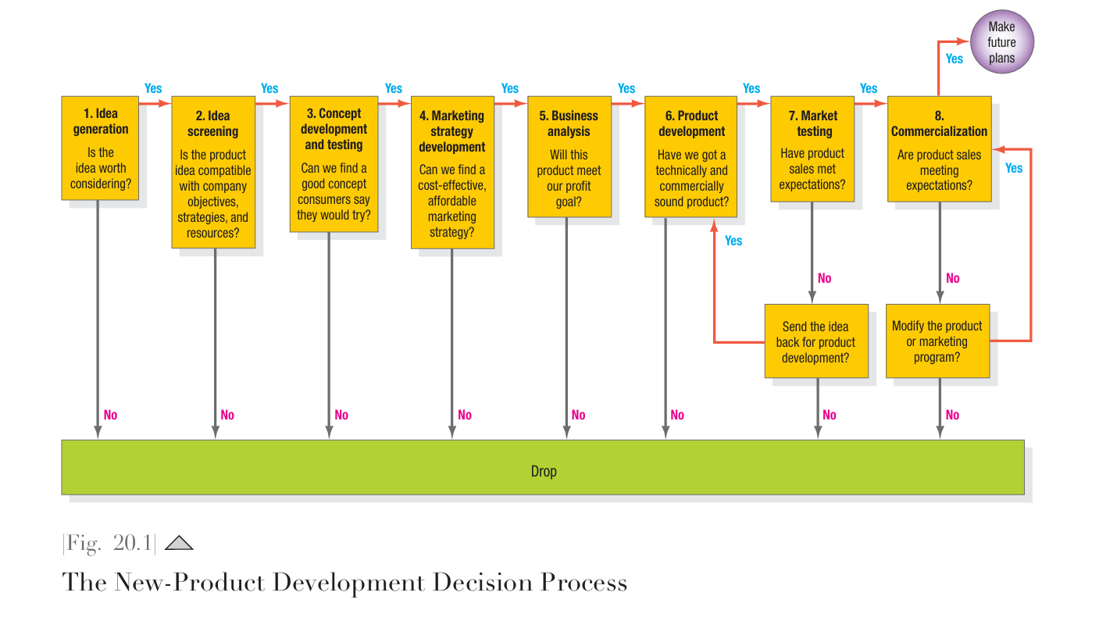

Slide 34
Idea Screening: In screening ideas, the company must avoid two types of errors. Accepting a poor idea and dropping a good idea. A DROP-error occurs when the company dismisses a good idea. It is extremely easy to find fault with other people’s ideas.
The purpose of screening is to drop poor ideas as early as possible. The rationale is that product development costs rise substantially with each successive development stage.
Most companies require new-product ideas to be described on a standard form for a new-product committee’s review.
The description states the product idea, the target market, and the competition and roughly estimates market size, product price, development time and costs, manufacturing costs, and rate of return.
The executive committee then reviews each idea against a set of criteria.
Does the product meet a need? Would it offer superior value? Can it be distinctively advertised? Does the company have the necessary know-how and capital? Will the new product deliver the expected sales volume, sales growth, and profit? Consumer input may be necessary to tap into marketplace realities

Slide 35
Concept Development & Testing: Attractive ideas must be refined into testable product concepts. A product idea is a possible product the company might offer to the market. A product concept is an elaborated version of the idea expressed in consumer terms.
Concept testing means presenting the product concept to target consumers, physically or symbolically, and getting their reactions. The more the tested concepts resemble the final product or experience, the more dependable concept testing is. Concept testing of prototypes can help avoid costly mistakes.
Marketing Strategy Development: Following a successful concept test, the new-product manager will develop a preliminary three-part strategy plan for introducing the new product into the market.
The first part describes the target market’s size, structure, and behavior; the planned product positioning; and the sales, market share, and profit goals sought in the first few years.
The second part outlines the planned price, distribution strategy, and marketing budget for the first year.
The third part of the marketing strategy plan describes the long-run sales and profit goals and marketing-mix strategy over time.

Slide 36
Business Analysis: After management develops the product concept and marketing strategy, it can evaluate the proposal’s business attractiveness.
Management needs to prepare sales, cost, and profit projections to determine whether they satisfy company objectives.
If they do, the concept can move to the development stage. As new information comes in, the business analysis will undergo revision and expansion.
Product Development: The job of translating target customer requirements into a working prototype is helped by a set of methods known as quality function deployment (QFD). The methodology takes the list of desired customer attributes (CAs) generated by market research and turns them into a list of engineering attributes (EAs) that engineers can use.
For example, customers of a proposed truck may want a certain acceleration rate (CA). Engineers can turn this into the required horsepower and other engineering equivalents (EAs). A major contribution of QFD is improved communication between marketers, engineers, and manufacturing people.

Slide 37
Market Testing: After management is satisfied with functional and psychological performance, the product is ready to be branded with a name, logo, and packaging and go into a market test.
The ultimate way to test a new consumer product is to put it into full-blown test markets. The company chooses a few representative cities and puts on a full marketing communications campaign, and the sales force tries to sell the trade on carrying the product and giving it good shelf exposure.
Test marketing also measures the impact of alternative marketing plans by implementing them in different cities.
Management faces several decisions:
How many test cities?
Which cities?
Length of test?
What information to collect?
What action to take?

Slide 38
A full-scale test can cost over $1 million, depending on the number of test cities, the test duration, and the amount of data the company wants to collect.
Many companies today skip test marketing and rely on faster and more economical testing methods.
General Mills prefers to launch new products in 25 percent of the country, an area too large for rivals to disrupt. Managers review retail scanner data, which tell them within days how the product is doing and what corrective fine-tuning to do.
Colgate Palmolive often launches a new product in a set of small “lead countries” and keeps rolling it out if it proves successful
Commercialization: Commercialization incurs the company’s highest costs to date. The firm will need to contract for manufacture or build or rent a full-scale manufacturing facility.
To introduce a major new consumer packaged good into the national market can cost $25 million to $100 million in advertising, promotion, and other communications in the first year.
For new food products, marketing expenditures typically represent 57 percent of first-year sales. Most new-product campaigns rely on a sequenced mix of market communication tools

Slide 39
Suppose a company has almost completed the development work on its new product and learns a competitor is nearing the end of its development work.
The company faces three choices:
First entry—The first firm entering a market usually enjoys the “first mover advantages” of locking up key distributors and customers and gaining leadership. But if rushed to market before it has been thoroughly debugged, the first entry can backfire.
Parallel entry—The firm might time its entry to coincide with the competitor’s entry. The market may pay more attention when two companies are advertising the new product.
Late entry—The firm might delay its launch until after the competitor has borne the cost of educating the market, and its product may reveal flaws the late entrant can avoid. The late entrant can also learn the size of the market.

Slide 40
What is Customer Life Time Value (CLV)?
Customer lifetime value (CLV) is a metric that measures how much a business can plan to earn from the average customer over the course of the relationship.
CLV is a measure of the total revenue and income a business can expect to bring in from a typical customer for as long as that person or account remains a client.
It's a key metric for understanding customer loyalty and the long-term value of a customer base, and it is calculated by multiplying the average purchase value, purchase frequency, and customer lifespan.
CLV = (Average transaction size) x (Number of transactions) x (Retention period)

Slide 41
Why CLV is Important?
Measures long-term value: Unlike single-transaction metrics, CLV provides a more complete picture of a customer's worth over time.
Indicates customer loyalty: A high CLV suggests strong customer loyalty and a sustainable business model.
Informs strategy: It helps businesses understand how much to invest in customer acquisition by comparing it to the expected return from a customer, and it can guide efforts to improve customer retention.
Highlights areas for improvement: A low CLV may signal a need to improve customer retention strategies or the overall customer experience.

Slide 42
How to Improve CLV?
Experienced marketers familiar with the four P’s of marketing - product, place, price, and promotion; have a strong understanding of how marketing efforts directly influence CLV.
It’s important to account for more than the gross revenue that customers are pulling in. By incorporating the four P’s mentioned above, businesses can derive more nuanced and actionable insights into how to improve their CLV and foster stronger, longer-lasting customer relationships.
Product: High-quality, innovative, and subscription-based products typically lead to longer customer retention and higher transaction values compared with commodity products.
Place: Where and how customers access your offerings - online, in-store, or through third-party platforms - affects transaction frequency and costs. For example, ecommerce may increase sales volume but introduce additional logistics expenses.
Price: Price increases can boost transaction size, but they may also push customers toward competitors or reduce their purchase frequency. Businesses must find the right balance between profitability and customer loyalty.
Promotion: Discounts, loyalty programs, and marketing campaigns can boost CLV by driving repeat purchases and attracting high-value customers. But overusing promotions and targeting them poorly can erode margins.

Slide 43
Unethical Issues in Marketing
Deceptive and misleading practices
False advertising: Making exaggerated claims about a product's benefits or using deceptive images.
Bait-and-switch: Advertising a product at a low price to attract customers, then claiming it's unavailable and pushing a more expensive alternative.
Misleading packaging: Using inaccurate labels or misrepresenting a product's size or content.
Fake reviews: Using fake testimonials or celebrity endorsements.
Privacy and data
Privacy invasion: Abusing the collection of personal data, a growing concern with digital marketing.
Unethical Market Research: Gathering information from consumers or competitors without their consent.

Slide 44
Unethical Issues in Marketing
Pricing and competition
Predatory pricing: Setting extremely low prices to drive competitors out of business and then raising prices.
Price fixing: Colluding with competitors to set prices artificially.
Price gouging: Artificially inflating prices during times of high demand.
Dumping: Selling products abroad for less than they cost to produce to gain market share, as seen with some products banned in the home market.
Product and supply chain
Harmful products: Promoting products that are harmful to health or the environment.
Omission of information: Failing to disclose important information, such as side effects of a product.
Built-in obsolescence: Designing products to have a limited lifespan to encourage repeat purchases.

Slide 45
Unethical Issues in Marketing
Exploitation and vulnerability
Targeting vulnerable groups: Marketing products in a way that exploits children, the elderly, or others who may lack the knowledge to make informed decisions.
Fear-mongering: Using manipulative tactics to play on consumers' fears to persuade them to buy a product.
High-pressure selling: Using aggressive techniques, often targeting vulnerable groups, to force a sale.

